Slide 1
SOCIAL PHARMACOLOGY
SOCIOPHARMACOLOGY
DR.Dr. Endang Isbandiati Soediono, MS, SpFK
Dept.Pharmacology&Therapy,MedicalFaculty,AirlanggaUniversity
Dept.Clinical Pharmacology,Dr.Soetomo-Teaching Hosptal,
SURABAYA

Slide 2
Social Pharmacology
A broad collection of disciplines pertaining to evaluating
the efficacy, safety, effectiveness, compliance, self-medication, and consumption of economic resources associated with the use of pharmaceutical products.

Slide 3
SOCIAL PHARMACOLOGY
Is the study of drug product use in a modern society and of understanding how society actually uses medicines.
A new approach to drugs in the postmarketing period :
. Research (clinical and social) in to the “real life” of drug in the community and
. Its consequenses for society, the goverment health authorities, health care services and drug manufactures

Slide 4
Social pharmacology encourages
Pharmacological research into the real life use of medicinal products and thus, guides individualized treatment of pts. and the development of new drugs.
It provides the conceptual framework to gain value-added knowledge about drugs, and for risk/benefit assesment of marketed drug products.

Slide 5
POSTMARKETING SETTING
Pts. should be aware that even though a medicinal product is registered as “safe and effective” by authorithies
Pts. may have false ideas on how to stay healthy and believe that medication is a good thing in it self without limitation.
No Drug is
Completely Safe or
Always Effective

Slide 6
Postmarketting setting (continued)
A pharmaceutical product
Broad spectrum people
A patient who takes a medicinal product
Not have the “mean” response as in the clinical trial
Established regulations, prescribing&dispensing correct
The great contrast between ideal clinical research condition and those found after marketing

Slide 7
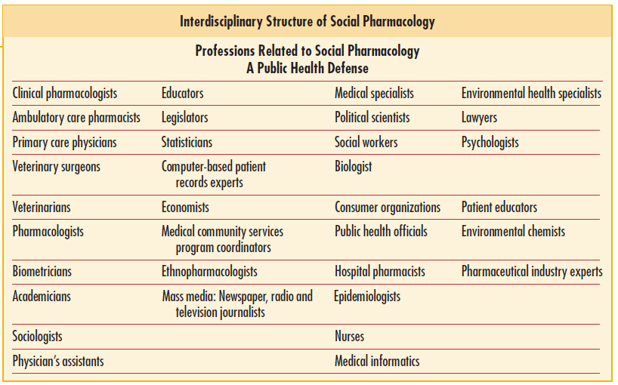

Slide 10
“ drug development is an ongoing process ; it does not stop because a drug is registered ; information about a drug is never complete “
Lasagna , 1980
Medicine is
a life long learning

Slide 11
Social Pharmacology (continued)
Pts. ~ DRUG PRODUCT
. HEATH CARE PROFESIONAL
. HEALTH ADMINISTRATION
. PHARMACEUTICAL INDUSTRY
. SOCIETY

Slide 12
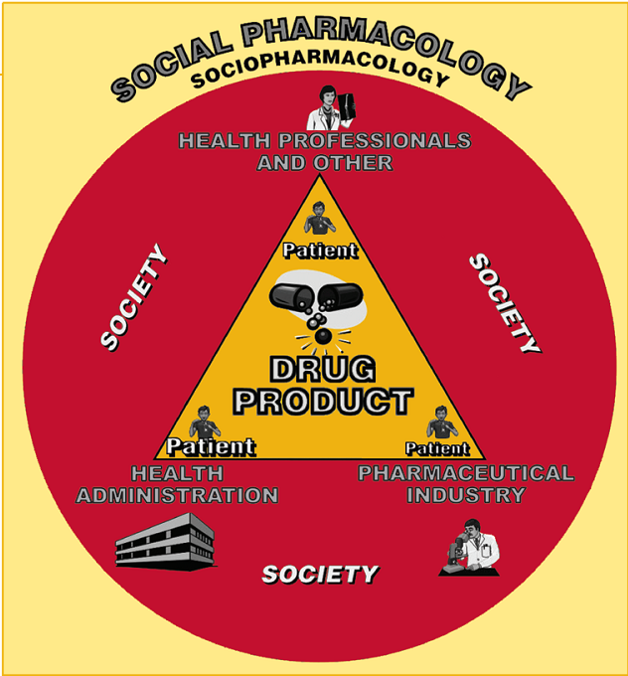

Slide 13
Social Pharmacology in Focus
Rational Drug Therapy
Contraception
Immunopharmacology
Antibiotics
Psychoactive
Traditional Medicine
Drug Management
Pharmacoeconomy

Slide 14
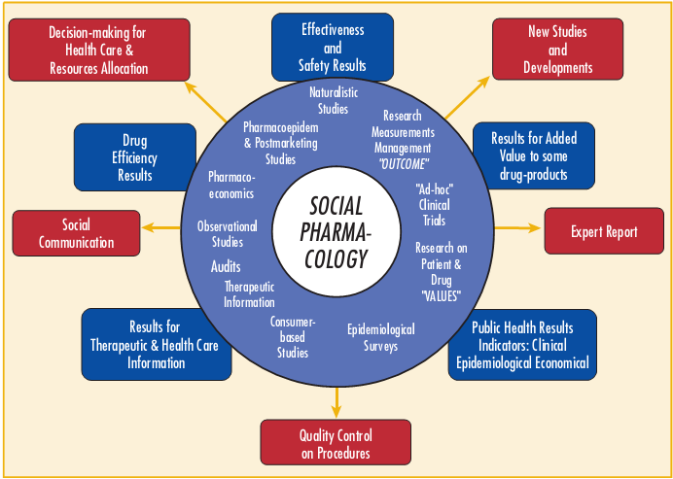

Slide 15
THANK YOU

