Slide 1
PENGANTAR TOKSIKOLOGI
Dr. H.Achmad Basori, MS
Profesor Farmakologi
Departemen Farmakologi Dan Terapi
Fakultas Kedokteran UA

Slide 2
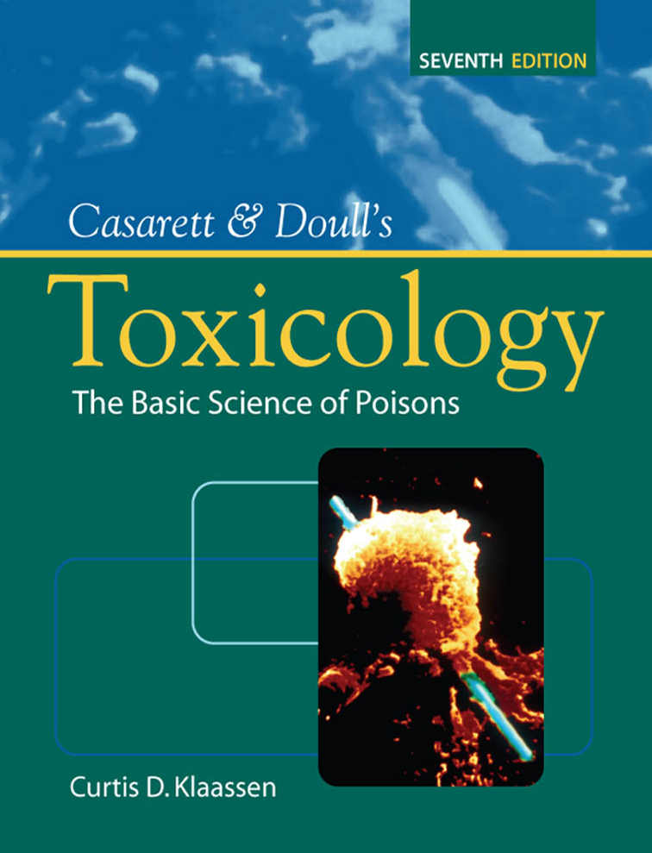

Slide 5
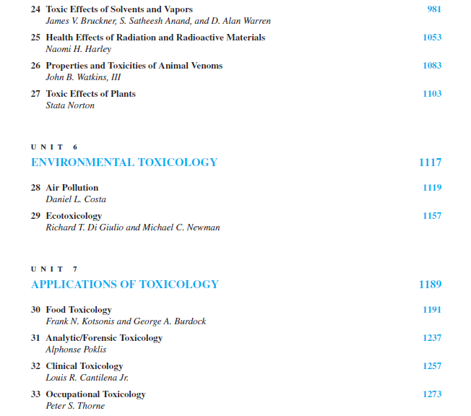

Slide 6
Pharmacology : Dogma and Reason
Ancient Beginnings
- Religious /magical
Hippocrates ( ~ 460 BC)
- Observation / experience
Paracelcus ( 1439 – 1541)
- Applyng chemistry to medicine
1600 – 1900 Materia Medica
- Experimental Physiology, Cause of Disease
- Isolation of Active Principles, Synthetic Chemistry
1900 ~ Modern Era
- Efficacy and Safety
- Clinical Trial

Slide 7
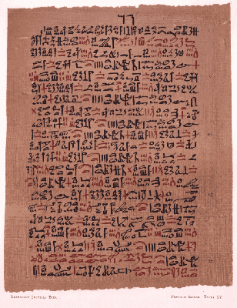
Ancient Beginnings
- Religious /magical
The Ebers papyrus, written in Egypt in the 16th
century B.C., lists the extensive pharmacopia
of that civilization. Included in this are: beer,
turpentine, myrrh, , juniperberries., poppy,
lead, salt and crushed precious stones.
Also included were products derived from
animals, including lizard's blood, swine teeth,
goose grease, ass hooves and the excreta
from various animals. The effects of many
of these drugs on patients of antiquity can
only be imagined.

Slide 8
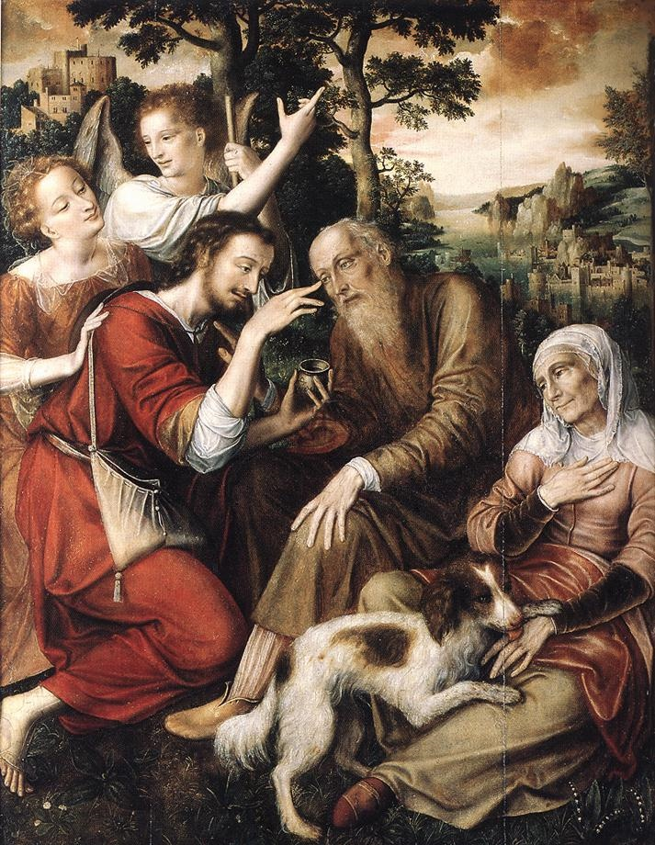
Hippocrates ( ~ 460 BC)
- Observation / experience (empiric- primitive)

Slide 9
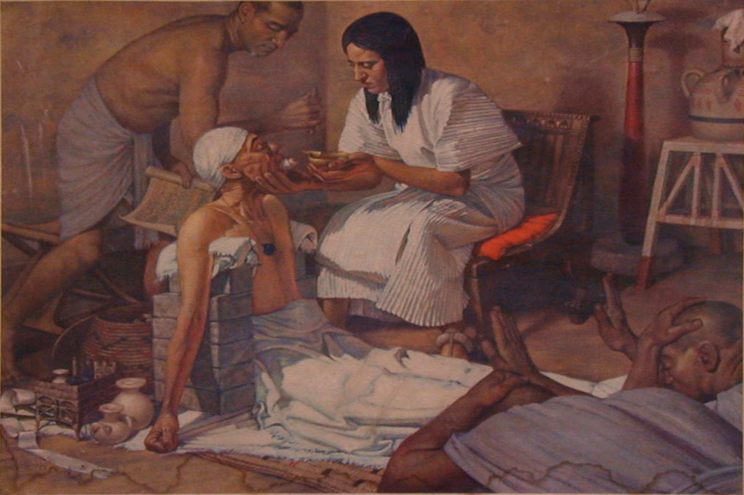
Paracelcus ( 1439 – 1541) → Pharmacon or Toxicon ?
- Applyng chemistry to medicine(empiric analytic)

Slide 10
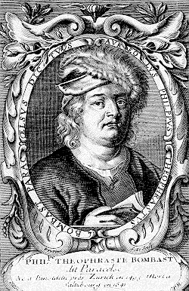
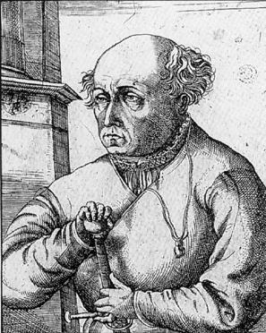
Swiss physician Paracelsus (1493-1541) credited with being
“the father of modern pharmacology/ toxicology.”
“All substances are poisons: there is none which is not a poison. The right dose differentiates a poison from a remedy.”
He determined that specific chemicals were actually responsible for the toxicity of a plant or animal poison.
Paracelsus is often quoted for his statement: "All substances are poisons; there is none which is not a poison. The right dose differentiates a poison and a remedy."
"The dose makes the poison.“

Slide 11

OBAT = PISAU BERMUKA DUA
MANFAAT : satu bahan bisa mendatangkan satu atau lebih efek
yg menguntungkan yg digunakan utk medikasi
MUDARAT : satu bahan mempunyai beberapa macam efek
yg merugikan dg berbagai tingkatan dari yg ringan
berat s/d fatal (side effect & adverse effect)
Besar kecilnya manfaat/mudarat yg muncul dalam pengobatan tergantung dari dosis.
Drug (Pharmacon) | Batas kadar terapi Dalam darah
Cyclosporine | 200-400 ng/ml
Phenytoin | 10 – 20 mg/ml
Gentamicin | 2 – 4 mg/ml
Theophylline | 10 – 20 mg/ml
Digoxin | 1 – 2 ng/ml
Obat = racun
Obat ”aman” bila digunakan dengan kaidah/hukum Farmakologi (Klinik)

Slide 12
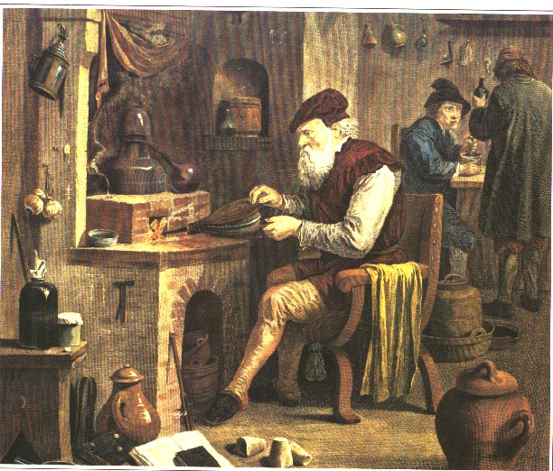
1600 – 1900 Materia Medica
- Experimental Physiology, Cause of Disease
- Isolation of Active Principles, Synthetic Chemistry

Slide 13

1900 ~ Modern Era
- Efficacy and Safety
- Modern Toxicology studies
- Clinical Trial

Slide 14
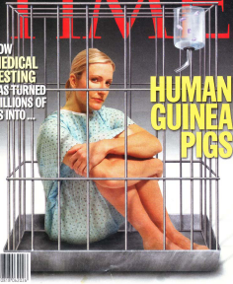
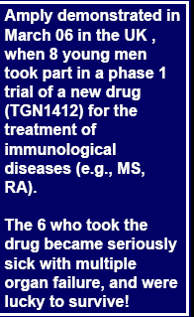

Slide 15
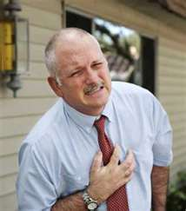
Isoproterenol (Isoprel) Inhaler
Bronchodilator
Cardiac Arrest
Isoproterenol → Pure beta receptor agonist ( non- selective)
Tidak mempunyai efek thd alpha-receptor

Slide 16
DRUG DISCOVERY & DEVELOPMENT PROCESSES
Overall cost per marketed compound = $ 1 – 1.2 billion
time-scale = 8 - 30 years
Total patent lifetime = ~30 years
DRUG
DISCOVERY
EARLY
DEVELOPMENT
CLINICAL DEVELOPMENT
Phase I
Phase II
Phase III
Phase IV
Target selection
Lead-finding
Lead optimisation
Pharmacological
profiling
Pharmacokinetics
Short-term
Toxicology
Formulation
Synthesis scale-up
Pharmacokinetics,tolerability, side effects in healthy
volunteers
Small-scale trials
in patients to assess
efficacy & dosage
Large-scale
controlled trials
Post-marketing
surveillance
2-5 years
(10-20%)
1 year
(3-5%)
5-7 years
(1-2%)
Drug
candidate
Development
compound
Compound approved for marketing
Chao Han dkk,2010
Rick et al,2010
Notes:
To develop a drug is a costly process. Only 10-20% of all potential drugs reach the level of early development, 3-5% clinical development and 1-2% finally reach the market.

Slide 17

What is Toxicology
Old Greek = poison
Modern Greek = Drug
Pharmacology :
Pharmakon + Logos?
Toxikon + Logos?
Toxicology :

Slide 18
Perkembangan Ilmu Toksikologi
Pharmacology (Pharmacon+Logos): Ilmu tentang senyawa (obat) yang digunakan untuk mencegah, mendiagnosa, dan mengobati penyakit
Toxicology (Toxicon + Logos) :
Suatu cabang dari ilmu farmakologi yang mempelajari efek yang tidak dikehendaki dari senyawa kimia pada sistem biologi (Undesirable) (ASPET,2000)
The Science of Poisons (ToxiCology)
The study of toxic effects of chemicals on living
systems. Study oh how natural or man made poisons cause undesirable effects in living organism
PATHOLOGY:
Study of structural and functional changes in cells, tissues and organs after toxic exposure

Slide 19
Efek Bahan / Obat
Desirable
Diharapkan
(Therapeutic)
Undesirable
Tidak Diharapkan
Non-deleterious
(Side effects)
Deleterious
(Toxic effects)

Slide 21
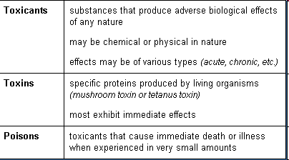
DEFINISI
-
Toxicosis : disease state that results from exposure to a poison.

Slide 22
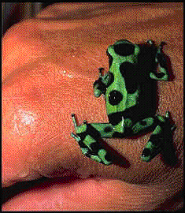
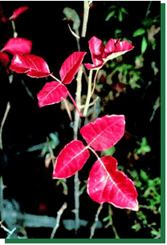
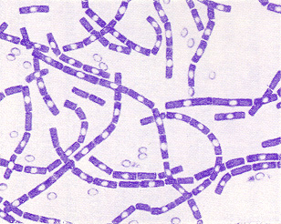
Toxicon
Poisonous substances are produced by plants, animals, or bacteria.
Phytotoxins
Zootoxins
Bacteriotoxins
Toxicant - the specific poisonous chemical.
Xenobiotic - man-made substance and/or produced by but not normally found in the body.

Slide 23
Xenobiotics ( Xenos, Foreign Chemical)
Xenobiotics may be naturally
occurring chemicals produced by
plants, microorganisms, or animals
(including humans).
Xenobiotics may also be synthetic chemicals produced by humans.
Poisons are xenobiotics, but not all xenobiotics are poisonous.
Xenobiotic are substances which normally is not needed by our body

Slide 24
History
Swiss physician Paracelsus (1493-1541) credited with being
“the father of modern toxicology.”
“All substances are poisons: there is none which is not a poison. The right dose differentiates a poison from a remedy.”
He determined that specific chemicals were actually responsible for the toxicity of a plant or animal poison.
Paracelsus is often quoted for his statement: "All substances are poisons; there is none which is not a poison. The right dose differentiates a poison and a remedy."
"The dose makes the poison.“

Slide 25
Paracetamol
→ dosis terapi : analgesik antipiretik
→ dosis tinggi → kanker hati
Viagra
→ dosis terapi : erectogenic
→ dosis tinggi : permanent blindness
Morphine
→ dosis terapi : analgesik kuat
→ dosis tinggi : depresi pernafasan
Air (H2O) :
→ 1 gelas : tdk apa apa
→ 1 galon : lambung pecah
Gula :
→ jumlah kecil : pemanis
→ jumlah besar : hyperglycemia → diabet → Coma

Slide 26
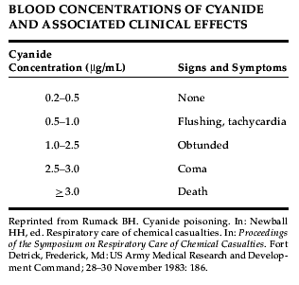


Slide 27
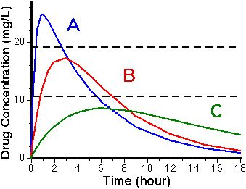
    Theophrastus von Hohenheim
    (Paracelcus,1493 – 1541)
    All things are poison, nothing is without poison
Toxic
Minimum Toxic Concentration
Therapeutic
Minimum Effective Concentration
    Ineffective

Slide 28
Pharmacon atau Toxicon = Drug Toxicity
Drug (Pharmacon) | Batas kadar terapi Dalam darah
Cyclosporine | 200-400 ng/ml
Salicylic acid | > 200 mg/ml
Phenytoin | 10 – 20 mg/ml
Gentamicin | 2 – 4 mg/ml
Theophylline | 10 – 20 mg/ml
Digoxin | 1 – 2 ng/ml

Slide 29
HIGH
DEATH
Coma
GENERAL
ANESTHESIA
        Confusion,
        Delirium,
        Ataxia
EFEK FARMAKOLOGI
Hypnosis
SEDATIVE
EFFECTS
    Drowsiness/
    decrease reaction time
ANTI-
CONVULSANT
EFFECTS
ANXIOLYTIC
EFFECTS
Dosis (mg/kg BB)
LOW
Phenobarbital (Luminal) → 5x dosis hipnotik → depresi nafas

Slide 30
Toxicity:
Derajad kemampuan suatu senyawa bersifat racun dan menyebabkan kerusakan
Toxicity tergantung : dosis, lama pemaparan, rute pemaparan,bentuk & struktur senyawa, faktor individu
Toxic :
Efek racun atau mematikan terhadap tubuh melalui inhalasi, oral, kontak langsung dgn bhn kimia
Toxicant : tiap bahan kimia yang dpt melukai atau membunuh manusia, hewan, tanaman = Poison.
Toxicant banyak dikaitkan dgn bahan yg dihasilkan dari produk hasil aktifitas manusia.Mis, Dioxin suatu bahan by produk pada proses khlrinasi bhn kimia.Arsenic merupakan kontaminan air atau hasil limbah industri
Toxin : Senyawa toksik hasil alam. Merupakan senyawa racun dari hewan, tanaman (bacterio toxin, Zootoxin, Phytotoxin
Toxicosis : Suatu penyakit yang terjadi akibat terpapar pada suatu toxicant

Slide 31
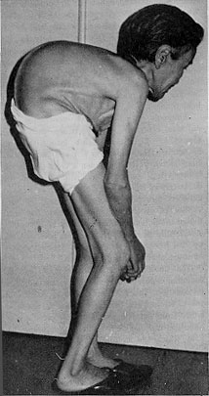
Itai Itai Disease
Penyebab terpapar cadmium secara khronik (Di daerah pertambangan , Jepang).
Akumulasi logam berat di air minum → gagal ginjal, perlunaan tulang, lumbago, arthralgia, dan full-body muscle spasm.
Diiringi rasa sakit hebat, patah tulang lengan/kaki, tubuh menjadi pendek
56 orang dila[porkan meninggal.

Slide 32
Klasifikasi Toxicant / Poison
Berdasarkan target organ : hepatotoxican,nephrotoxicant,cardiotoxicant, dll
Berdasarkan penggunaannya: pesticide,solvent,food additive,dll)
Berdasarkan asal bahan: animal toxins, plant toxins
Berdasarkan efek: mutation,cancer,liver injury,dll
Berdasarkan siFat fisik: gas, dust, liquid
Berdasarkan reaktifitas kimia labeling:explosives,flammable,oxidizer,dll)
Bedasarkan struktur kimia : aromatic amine,halogenated hydrocarbon,dll
Berdasarkan potensi toxicant : extremely toxic,very toxic, super toxic, dll
Berdasarkan mekanisme kerja : sulhydriyl inhibitor,methoglobin producer,dll)

Slide 33


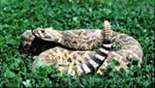
Toxicant ( Poison = Xenobiotics)
Obat-Obatan (Psikotropik=Sedatives-hypnotics,Tranquillizer,Antidepressant,cardiovascular,Hormon,Alcohol,street drugs,Obat obat OTC,dll)
Cleaning/polishing agent,hydrocarbon, paint,pestisides,corrosive,ll)
Foods,Botulinum, TTX,Insect bites,dll)
Animal toxin (TTX, insect bites,dll)
Gas (CO,NO,Freon,dll)
Industrial product (heavy metals): As, Pb, Hg,Cd,Chrom,Ba,Li,Fe,dll
Cosmetics
Venome
Dan lain lainnya

Slide 34
Basic Science
Biology, Biochemistry,Pathology, Physiology, Genetic, Pharmacology
TOXICOLOGY
Medical Toxicology :
- Biochemical Toxicology
- Analytical Toxicology
- Cellular Toxicology
Molecular Toxicology
- Clinical Toxicology
- Forensic Toxicology
-Food Toxicology
- Ecotoxicology
- Industrial Toxicology
-Enviromental Toxicology
-Occupational Toxicology
-Developmental
and reproductive Toxicology
-Regulatory Toxicology
-Mechanistic Toxicology
- Descriptive Toxicology

Slide 35
Area toksikologi khusus yang penting utk kedokteran :
Forensic toxicology → kombinasi kimia analitik dan toksikologi dasar yang memperhatikan aspek medikolegal
Clinical toxicology → fokus pada penyakit yang disebabkan atau secara unik berhubungan dengan substansi toksik
Occupational toxicology → Toksikologi di tempat kerja
- berhub dg bhn kimia disekitar tempat kerja
- terutama identifikasi “agent”
- kondisi tempat kerja aman, absorbsi bahan kimia berlebih
dapat dicegah
- guideline → konsentrasi bahan kimia di udara yang pasti aman
(establish) → ada daftar bahan kimia yg direkomendasikan
memenuhi threshold limit values (TLVs).
Guideline selalu di evaluasi → new information

Slide 36
TOKSIKOLOGI LINGKUNGAN
- berhubungan dg dampak kimia sbg polutan di lingkungan organisme hidup → udara, tanah, air, dll
- target utama manusia, spesias lain target biologik potensial
Polusi udara → produk industri
pengembangan teknologi
peningkatan urbanisasi
Polusi tanah dan air → pestisida
Pengolahan makanan → residu bahan kimia pada produk makanan

Slide 38
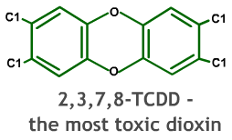
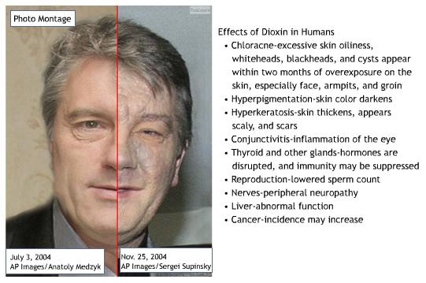
Ukrainian president Viktor Yushchenko, after alleged poisoning with dioxin, and, possibly endotoxin, prior to the 2004 elections.

Slide 39
MOLECULES OF DEATH
1.Aflatoxin
2. Botulinus Toxin
3. Carbon Monoxide – Ther Silent Killer
4. Domoic Acid
5. Ecstacy
6. Heroin
7.Hydrofluoric Acid
8.Hydrogen Sulphide
9.Lead : An old and Modern Poison
10.Mercury
11.Mushroom Toxin
12.Nerve Gases
13.Nicotine and Tobacco Alkaloid
14.Paracetamol (Acetominophen)
15.Paraquat and Diquat
16.Phosphorus
17.Radon
18.Ricin
19.Snake Toxin
20.Spider Toxin
21.Strychnine
22.Tetrodotoxin
23.Thallium
24.Arsen
25.Cyanide
1.

Slide 40
Keracunan bahan kimia di IRD RSUD Dr. Soetomo Surabaya dalam 5 tahun terakhir (Hernomo, 2001)
Nama Bahan 1996 1997 1998 1999 2000
1. Pestis. 128 (32.82%) 150 (29.30%) 84 (22.11%) 75 (22.52%) 78 (31.84%)
2. Ob. Farm. 120 (30.77%) 227 (44.34%) 159 (41.84%) 137 (41.14%) 81 (33.06%)
3. Minyak 60 (15.38%) 45 (8.79%) 29 (7.63%) 38 (11.41%) 32 (13.06%)
4. Makanan 13 (3.33%) 35 (6.84%) 39 (10.26%) 23 (6.91%) 8 (3.27%)
5. Alkohol 24 (6.15%) 14 (2.73%) 22 (5.79%) 30 (9.01%) 20 (8.16%)
6. Rmh tng 8 (2.05%) 11 (2.15%) 7 (1.84%) 5 (1.50%) 3 (1.22%)
7. Gas 2 (0.51%) 4 (0.78%) 2 (0.53%) 0 (0%) 0 (0%)
8. Ob. Trad. 11 (2.82%) 3 (0.59%) 6 (1.58%) 12 (3.60%) 2 (0.82%)
9. Korosif 18 (4.62%) 14 (2.73%) 10 (2.63%) 11 (3.30%) 5 (2.04%)
10. Lain-lain 2 (0.60%) 0 (0%) 0 (0%) 0 (0%) 3 (1.22%)
11. Tak diket. 6 (1.54%) 16 (4.21%) 0 (0%) 0 (0%) 13 (5.31%)
Total 390 (100%) 512 (100%) 380 (100%) 333 (100%) 245 (100%)

Slide 41
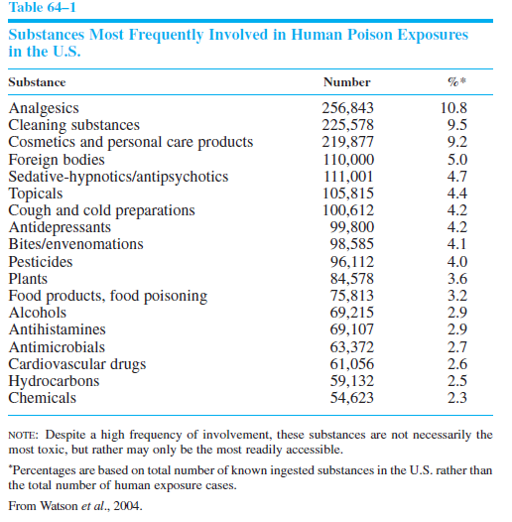

Slide 42
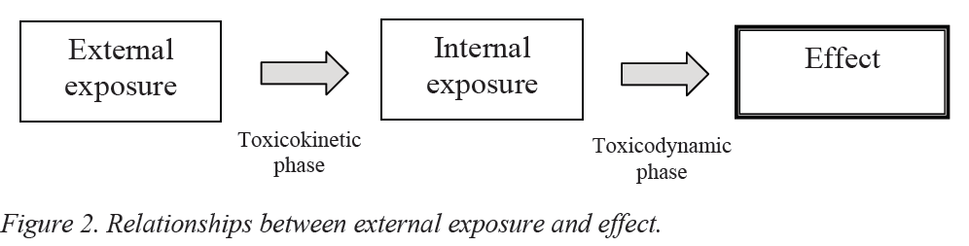
TOXICOKINETICS AND TOXICODYNAMIC
Bagaimana toksikan memasuki tubuh ?
Bagaimana nasib toksikan didlm tubuh ?
Bagaimana efek tubuh terhadap terhadap toxicant ?
Bagaimana efek toksikan terhadap tubuh ?
Bagaimana cara penanganan intoksikasi ?
Dll

Slide 43
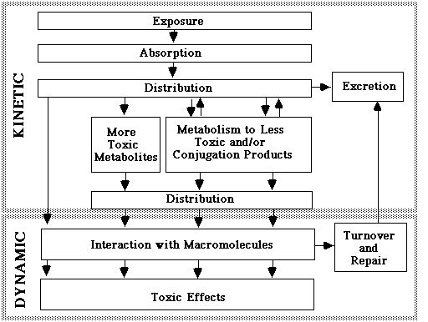

Slide 44
TOXICOKINETICS (TOKSIKOKINETIK)
Studi pengaruh tubuh terhadap toksikan dan pergerakan toksikan didalam tubuh
MTC
Therapeutic
MEC
    Ineffective

Slide 46
Bioaccumulation = the accumulation of a contaminant or toxin in or on an organism
from all sources (e.g., food, water, air).
Biomagnification = the increase in concentration of toxin as it passes through successive levels of the food web

Slide 47
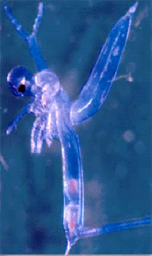
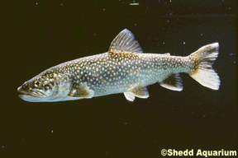
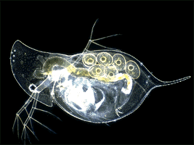
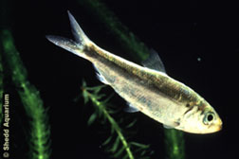
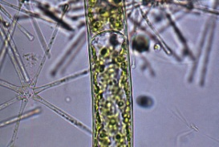
Bioaccumulation
Assimilation Efficiency (= Lindeman’s Efficiency
Lindeman 1942. Ecology 23: 399-418)
AE increases with trophic level
When a chemical is assimilated more efficiently than
organic energy -> bioaccumulation
AE

Slide 48
Biomagnification
Scenario 1: Alewife (2º predator) eats Cercopagis 1º predator
cals.
1
10
100
ppm toxin
1
100
10,000
Scenario 2
cals.
1
100
ppm toxin
1
1000

Slide 49
Food Web Bioaccumulation

Slide 50
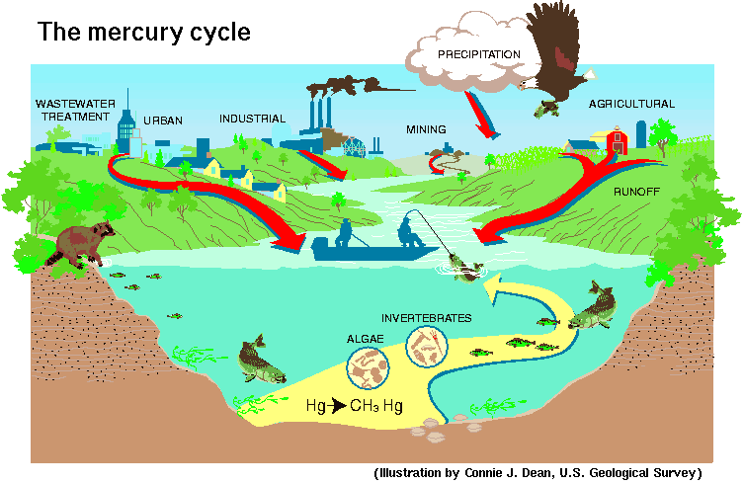
The Mercury Cycle

Slide 51
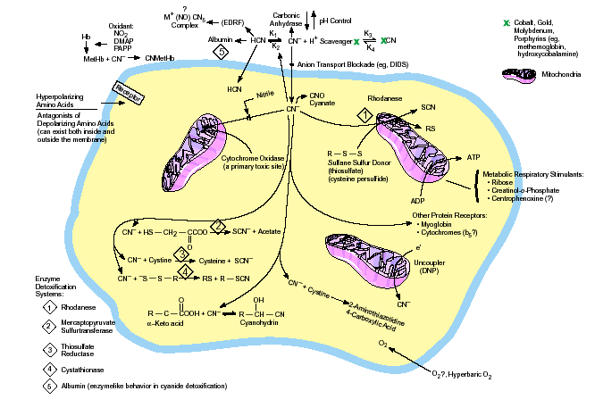
TOXICOKINETICS:
Study of the time-course of toxins (study of what the body does to the toxin).

Slide 52
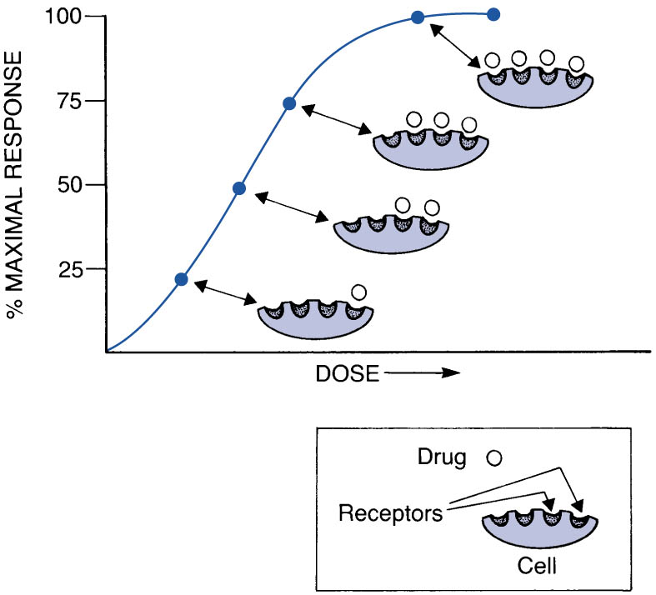
TOXICODYNAMICS (TOKSIKODINAMIK)
Studi efek pengaruh toksikan terhadap tubuh

Slide 53
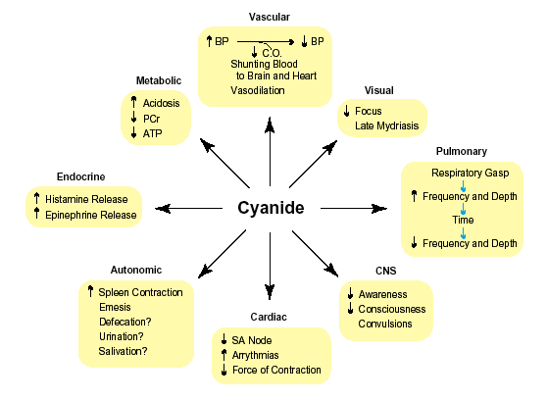
TOXICODYNAMICS:
Study of biochemical and physiological effects of drugs and toxins (study of what the toxin does to the body).

Slide 54
Target Organ Toxicity
-Central Nervous System – lead
-Immune System - isocyanates
-Liver - ethanol, acetaminophen
-Respiratory Tract - tobacco smoke, asbestos, ozone
-Eye - UV light (sunlight)
-Kidney - metals
-Skin - UV light, gold, nickel
-Reproductive System –dibromochloropropane

Slide 55
Karakteristik
Rute Pemaparan Toksikan
(Exposure)
Rute dan Titik tangkap Pemaparan
  Ingestion (Gastrointestinal Tract)
  Inhalation (Lungs)
  Dermal/Topical (Skin)
  Injection
    intravenous, intramuscular, intraperitoneal
Effectiveness pemaparan:
iv > inhale > ip > im > ingest > topical

Slide 56
Dosis
Jumlah bahan kimia / Toxicant yang memasuki tubuh Umumnya dalam satuan mg /kg BW
Dosis Toxicant tergantung pada bbp faktor :
→ concentration di lingkungan sekitarnya
→ Karakteristik exposure
→ Lama exposure
→ Frekwensi exposure
→ Sifat toxicant

Slide 57
Toxicant
Toxicant
Toxicant

Slide 58
MEKANISME TRANSPORT
DARI TOXICANT
Passive
diffusion
Carrier-mediated
transport
Active
Facilitated
ATP
ADP-Pi
Transporter
Molecule

Slide 59
Memerlukan carrier
Transport menjadi jenuh (saturated) pada konsentrasi tinggi
Proses bersifat selective
Dua obat yang ditranspor oleh mekanisme yg sama akan menghambat satu sama lain
Melawan concentration gradient ( active transport)
Tdk melawan cocentration gradient ( facilitated
transport)
Memerlukan energy
Mekanisme transport dapat dihambat oleh obat obat yang mempengaruhi cellular metabolism
Karakteristik facilitated diffusion dan active transport

Slide 60
Karakteristik dari molekul Un-ionized
Dan Ionized Toxicant
Un-ionized Ionized
Pharmacologic effect Active Inactive
Solubility Lipids Water
Cross lipid barriers Yes No
(gastrointestinal tract,
blood-brain barrier, placenta)
Hepatic metabolism Yes No
Renal excretion No Yes

Slide 61
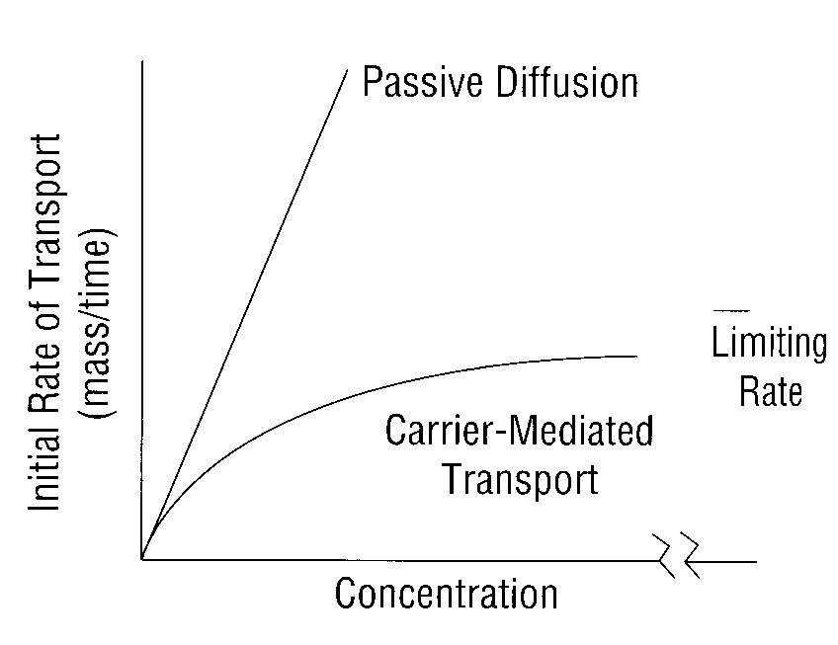

Slide 62
Absorption:
Kemampuan bhn kimia memasuki darah
(darah berkesimbangan dgn jaringan)
Inhalasi--gas menuju darah melalui alveoli. (luas permukaan alveolar, aliran darah banyak, lapisan antara darah menuju alveolar air)
Ingestion--absorpsi melalui GI tract : stomach (asam), small intestine (contact time panjang, luas permukaan luas--villi; bases dan transporter bahan bahan tertentu)
  1st Pass Effect (liver metabolism)
Dermal—absorpsi melalui epidermis (stratum corneum), dermis; titik tangkap dan keadaan kulit

Slide 63
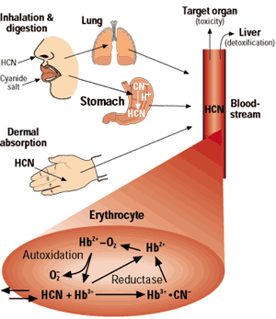

Slide 64
Surface area approximately 50 to 100 m²
Pharynx
Nasopharynx
Oropharynx
Epiglottis
Thyroid cartilage
Larynx
Cricoid cartilage
Trachea
Bronchiole
Right main bronchus
Left main bronchus
Bronchiole
Diaphragm
Lungs

Slide 65
Respiratory Physiology
O
CO
O
2
2
2
CO
2
Blood from right
side of heart
Aveolus
(low in O,
2
high in CO)
O
O
2
2
2
CO
CO
Blood to left
2
2
side of heart
.
Reoxygenated blood
Capillary
(high in O, low in CO)
2
2
Red blood cells

Slide 66
Absorpsi Pulmonary
Systemic (e.g. insulin, anesthetics)
dan local delivery
Area absorpsi sangat luas
Suplai darah sangat baik
Tidak mengalami first pass effect
Bentuk sediaan mahal
Ukuran partikel : 2-5 m

Slide 67
Absorption from the Lungs
REMOVAL OF
PARTICLES
Absorption of Aerosols and Particles:
1- Particle Size
2- Water solubility of the chemical present in the aerosol or particle
Physical
Lymph
Phagocytosis

Slide 68
Pemberian per inhalasi
Patikel > 10 um : diendapkan, dihembuskan dan berbangkis
Partikel < 0.01 um : terbuang pada saat inspirasi dan ekspirasi
Partikel 0.01 – 10 um :diendapkan pada alveoli, nasopharyng sampai bronchioli
25% dikeluarkan bersama udara nafas
50% diendapkan disalurannafas bagian atas
25% diendapkan disaluran nafas bagian bawah

Slide 69
Absorpsi dari Paru
Gas, vapors,volatile liquids, aerosols and particles
Large surface area, thin barrier, high blood flow rapid absorption
Blood:air partition coefficient –
dipengaruhi respiratory rate dan blood flow
Blood:tissue partition coefficient

Slide 70
DEPOSISI PARTIKEL TOKSIKAN DI DLM SALURAN RESPIRASI
NasopharyngealRegion
5-30 µm
Trachea
Bronchi
Bronchioles
1-5 µm
Alveolar Region
1 µm

Slide 71
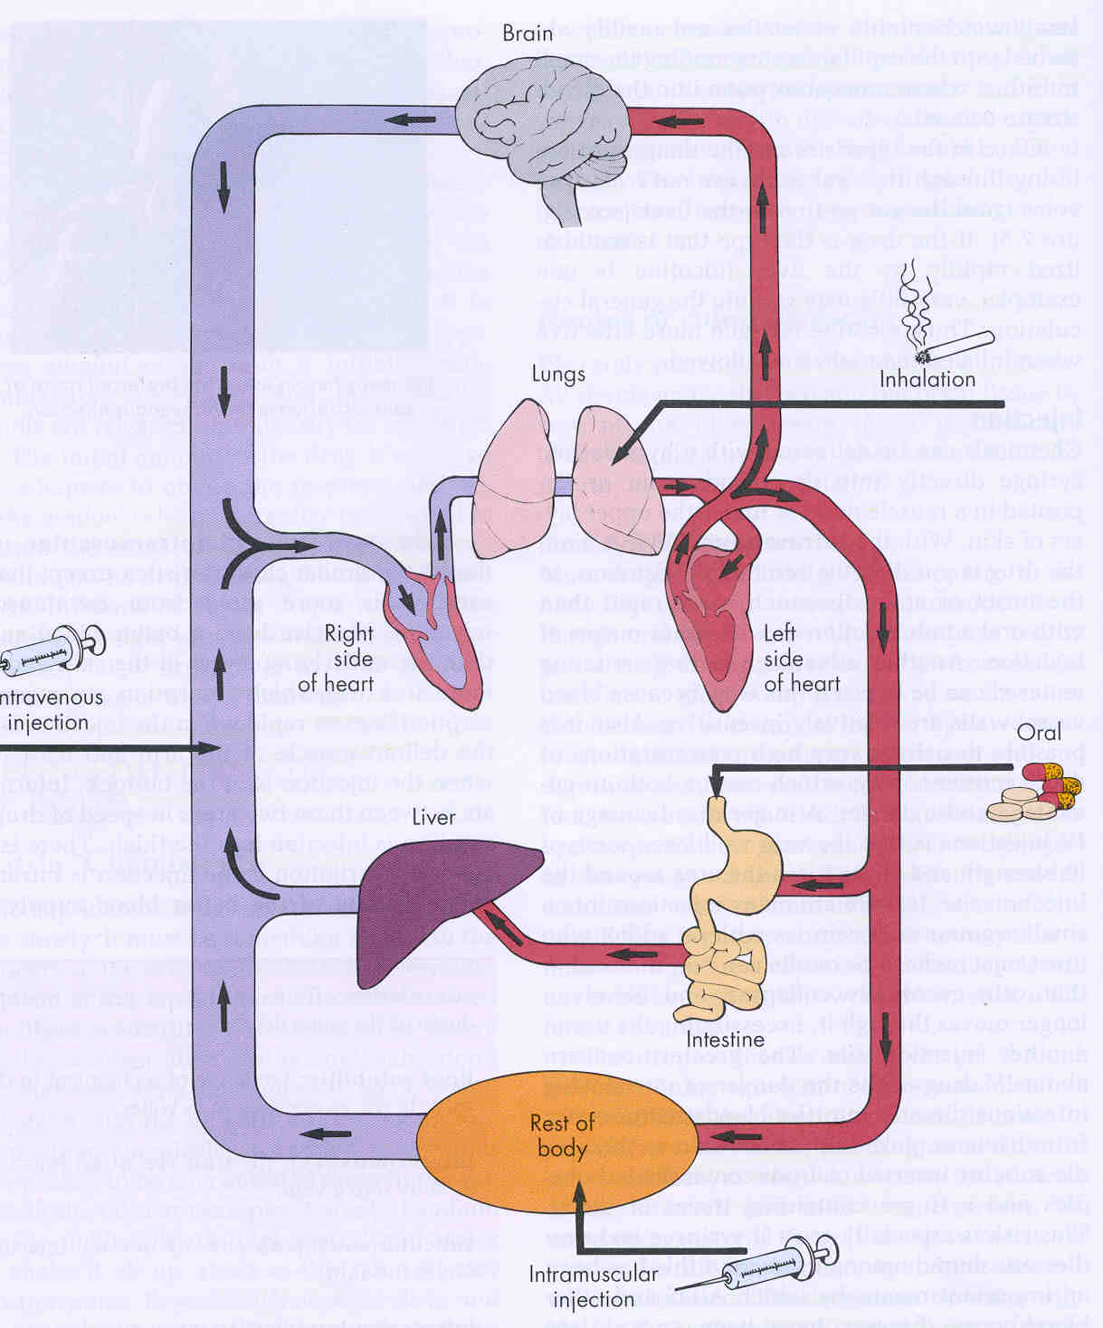

Slide 72
Absorpsi dari kulit
Melewati bbg lapisan sel (stratum corneum, epidermis, dermis) menuju pembuluh darah .
Faktor yang mempengaruhi :
lipid solubility, hydrasi kulit
(sole of feet vs. scrotum)

Slide 73
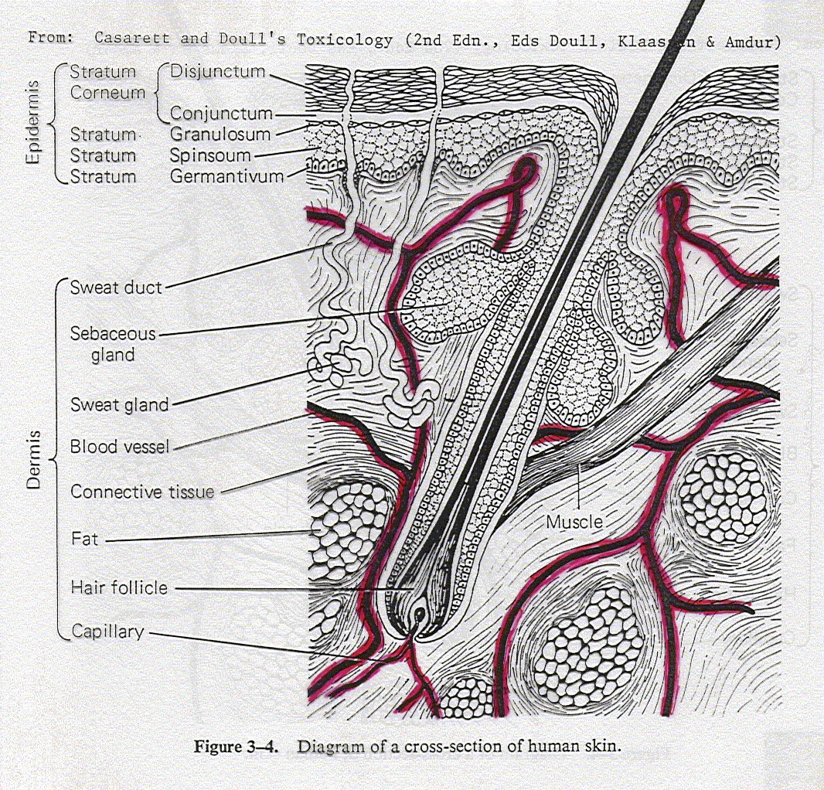

Slide 74
Absorption by the Skin

Slide 75
Absorpsi melalui kulit
Permeability depends on the diffusivity and thickness (depends on the area of the body) of the stratum corneum
Polar → outer surface of protein filaments of the hydrated stratum corneum
Nonpolar → lipid matrix between protein filaments
Percutaneous absorption → lower layers of the epidermis and dermis
Below the s.corneum → porous, nonselective aqueous medium
Compromised stratum corneum integrity
Increased stratum corneum hydration
Increased temperature → increased blood flow
Low solubility of toxicant in the vehicle
Small size → Increased Absorption

Slide 76
Distribution: proses translokasi dari Toxicant menuju seluruh bagian tubuh
Darah membawa Toxicant menuju site of action, storage depots, organ transformasi, dan organ eliminasi
Kecepatan distribusi Toxicant tergantung :
-- aliran darah
  karakteristik toxicant (afinitas thd jaringan dan partition coefficient)
Distribusi mungkin berubah setiap waktu

Slide 77
Distribusi:
Storage / Binding
Storage di dlm Adipose tissue → sangat lipophylic (DDT). Cepat dimobilisasi dari fat (starvation) , cepat meningkat dalam darah cepat meningkat dalam darah
Storage dalam tulang (Bone) → Chemicals analog dgn Calcium--Fluoride, Lead, Strontium
Ikatan dgn Plasma proteins → mendesak senyawa endogenous . Hanya fraksi bebas → adverse effects dan excretion

Slide 78
Metabolism:
Toxicant lebih water soluble (Polar) → ekskresi
  Menurunkan lipid solubility → menurunkan jumlah toxicant pada target
  Meningkatkan ionisasi → meningkatkan excretion rate --> menurunkan toxicity
Bioactivasi → Biotransformasi → pembentukan reactive metabolites

Slide 79
Biotransformation (Metabolism)
Meningkatkan kec clearance dari toxicant
Dapat terjadi mulai absorpsi → ekskreri

Slide 80
Biotransformation
Key organs in biotransformation
  LIVER (high)
  Lung, Kidney, Intestine (medium)
  Others (low)
Biotransformation Pathways
  Phase I--make the toxicant more water soluble
  Phase II--Links with a soluble endogenous agent (conjugation)

Slide 81
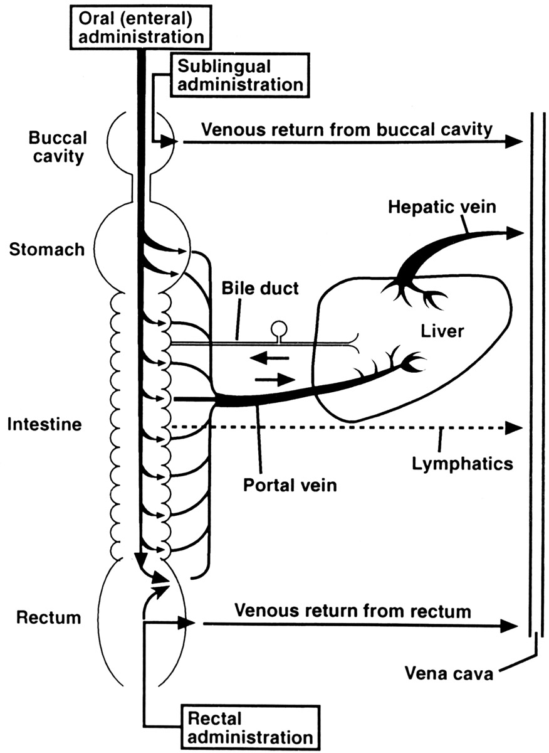
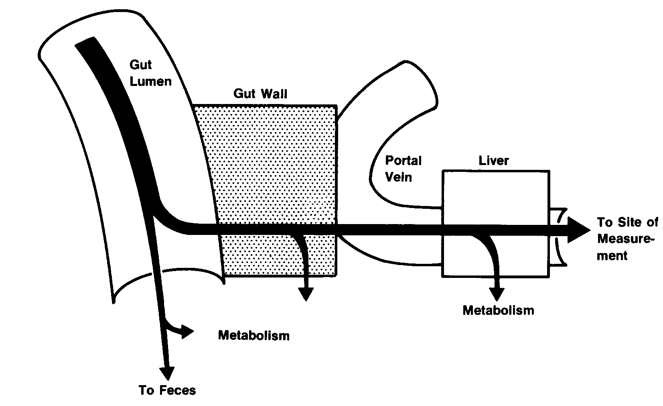
FPE
Beberapa toxin tidak efektif bila digunakan peroral (snake venome)
Bila toxicant dimetabolisme menjadi bentuk aktif (ultimate toxicant) → kumulatif dari metabolit toxic

Slide 82
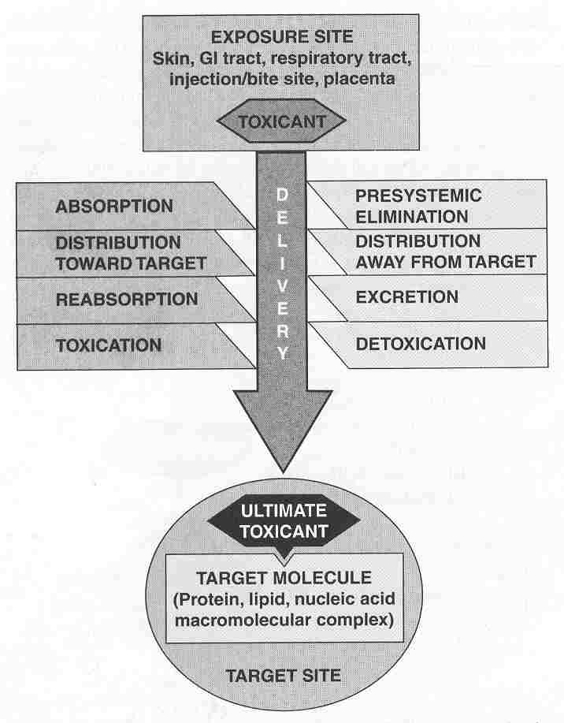

Slide 83
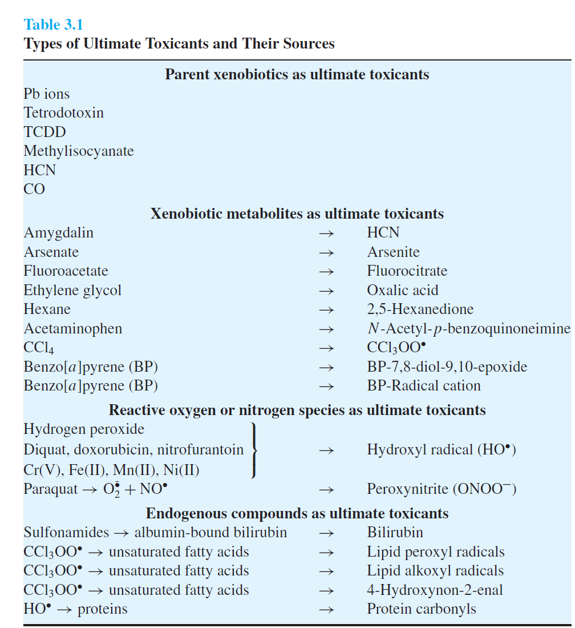

Slide 84
Distribution:
the process in which a chemical agent translocates throughout the body
Blood carries the agent to and from its site of action, storage depots, organs of transformation, and organs of elimination
Rate of distribution (rapid) dependent upon
  blood flow
  characteristics of toxicant (affinity for the tissue, and the partition coefficient)
Distribution may change over time

Slide 85
Distribution:
Storage and Binding
Storage in Adipose tissue--Very lipophylic compounds (DDT) will store in fat. Rapid mobilization of the fat (starvation) can rapidly increase blood concentration
Storage in Bone--Chemicals analogous to Calcium--Fluoride, Lead, Strontium
Binding to Plasma proteins--can displace endogenous compounds. Only free is available for adverse effects or excretion

Slide 86
Target Organs: adverse effect is dependent upon the concentration of active compound at the target site for enough time
Not all organs are affected equally
  greater susceptibility of the target organ
  higher concentration of active compound
Liver--high blood flow, oxidative reactions
Kidney--high blood flow, concentrates chemicals
Lung--high blood flow, site of exposure
Neurons--oxygen dependent, irreversible damage
Myocardium--oxygen dependent
Bone marrow, intestinal mucosa--rapid divide

Slide 87
Target organ
Carbon tetrachloride – liver
Mercury & lead – CNS, kidneys & hematopoietic system
Benzene – hematopoietic system
Storage sites
Dichlorodiphenyltrichloroethane (DDT) – fat depots → no toxic effect

Slide 88
Nose is a “scrubber” for water-soluble and highly reactive gases
Solubility ratio (blood-to-gas partition coefficient) – conc. in blood/conc. in gas phase before or at saturation
Low solubility ratio – blood flow through the lungs (perfusion-limited)
Highs solubility ratio – rate and depth of respiration (ventilation-limited)
Lungs are capable of biotransformation & elimination
Steady state concentration can be reached
Aerosols → dependent on aerosol size & water solubility
5um or more – lodged in nasopharyngeal region
2.5 um – tracheobronchial region
1 um or less – alveolar sacs of blood

Slide 89
Efek Toxic Berdasarkan Mekanisme
Allergic (hypersensitivity,Antigen)
Idiosyncratic (e.g. G6PD def., Drugs)
Local vs. Systemic (Corrosive agent)
Reversible vs. Irreversible
Necrosis /organ damage (Ozone, Lead, Cd, Sr)
Carcinogenecity (Benzene, Rokok, Asbestos, Coloring Agent)
Mutagenicity (uv light, Coloring Agent)
Teratogenicity (Drugs:Thalidomide, Valproic acid, Herbal)
Death (Arsen, Cyanide)
Notes:
89

Slide 90
Efek Toksik Berdasarkan
Lama Pemaparan (Exposure)
Acute toxicity < 24hr umumnya 1 x paparan
Subacute toxicity 1 bulan dosis berulang
Subchronic toxicity 1-3 bulan dosis berulang
Chronic toxicity > 3 bulan dosis berulang
Pada pemakaian berulang → akumulasi Toxicant didalam tubuh

Slide 91
Sifat Toxicant
Acute Toxicity
Biasanya menyebabkan kematian
Th 1989, 5,000 orang meninggal dan 30,000 cacat
permanen akibat terpapar methyl isocyanate akibat kebocoran
industri di India.
Subchronic Toxicity
- Minum coumadin tablets (blood thinners) beberapa
minggu pada pengobatan venous thrombosis menyebabkan
perdarahan internal .
Chronic Toxicity
- cirrhosis pada alcoholics (beberapa tahun)
- chronic kidney disease pada pekerja terpapar Pb beberapa tahun
- chronic bronchitis pada cigarette smokers
- pulmonary fibrosis pada pekerja tambang (black lung disease)
- Carcinogenicity, Mutagenicity
- Developmental Toxicity, Teratogenicity
Embryolethality,embryotoxic,teratogenic
- Genetic Toxicity (somatic cells)
Gene mutation,chromosome aberration,aneuploidy,polyploidy

Slide 92
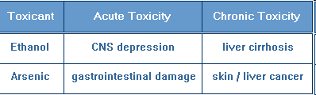

Slide 93
Target Organs: adverse effect tergantung pada kadar senyawa aktif dlm target site untuk waktu yang cukup
Tidak semua organ dipengaruhi sama ,tetapi tergantung
  Kepekaan target organ
  Kadar toxicant yg tinggi dalam target organ
Liver—aliran drh sangat tinggi,oxidative reactions
Kidney—aliran drh sangat tinggi, bhn kimia terkonsentrat
Lung--high blood flow, tempat pemaparan
Neurons--oxygen dependent, kerusakan irreversible
Myocardium--oxygen dependent
Bone marrow, intestinal mucosa -- rapid divide cell

Slide 94
Target Sites:
Mechanisms of Action
Adverse effects can occur at the level of the molecule, cell, organ, or organism
Molecularly, chemical can interact with
  Proteins Lipids DNA
Cellularly, chemical can
  interfere with receptor-ligand binding
  interfere with membrane function
  interfere with cellular energy production
  bind to biomolecules
  perturb homeostasis (Ca)

Slide 95
Excretion:
Toxicants are eliminated from the body by several routes
Urinary excretion
  water soluble products are filtered out of the blood by the kidney and excreted into the urine
Exhalation
  Volatile compounds are exhaled by breathing
Biliary Excretion via Fecal Excretion
  Compounds can be extracted by the liver and excreted into the bile. The bile drains into the small intestine and is eliminated in the feces.
Milk Sweat Saliva

Slide 96
Mekanisme kerusakan sel (cellular injury)
Perubahan permeabilitas cell membrane
Perubahan enzymes activity.
Modifikasi carriers.
Reaksi yg menyebabkan deplesi GSH.
Interaksi dgn co-enzyme.
Interaksi dgn nucleic acid.
Pembentukan reactive metabolite.
Perubahan protein synthesis.
Immunotoxicity.
Perubahan Lysosomal
Inhibisi cellular respiration.

Slide 97
Occupancy Theory
T + R
T-R Complex
Response

Slide 98
Law of Mass Action
[R].[T].k_{f}
[RT].k_{b}
R + T RT
Kec. asosiasi = [R].[T].k_{f}
Kec. disosiasi = [RT].k_{b}
Pada keseimbangan → [R].[T].k_{f} = [RT].k_{b}
Keduanya dibagi dengan k_{f} [R].[T]=[RT].k_{b}/k_{f} (1)

Slide 99
Let K_{d} = k_{b}/k_{f} [R].[T]=[RT].K_{d} (2)
[R_{t}] = total no. receptors [R_{t}] = [R] + [RT]
Subst [R] = [R_{t}]-[RT] ke (2) [T]([R_{t}]-[RT]) = [RT].K_{d}
Selanjutnya [RT](K_{d}+[T]) = [T].[R_{t}]
Dibagi dengan [R_{t}] [RD](K_{d}+[T])/[R_{t}] = [T]
Dibagi oleh (K_{d} + [T])
[RT] = [T]
[R_{t}] [T] + K_{d}
Besarnya efek toksik sebanding dengan komplek TR yaitu E ~ [TR]
Respon maximum terjadi bila semua reseptor diduduki toksikan, yaitu Emax ~  [Rt]
Fraksi reseptor yang diduduki toxicant = efek = respon = RT / Rt

Slide 100
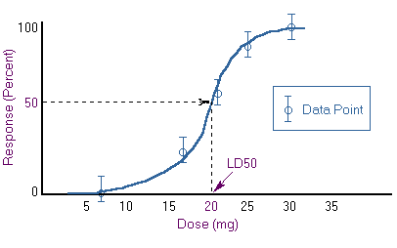

Slide 101
Model dari “Occupancy Theory”
Toxicant

Slide 102
Dose Response Relationship
All Effected
100
80
75
% Response
50
Half Effected
25
NO Adverse Effect level
20
0
0
10
20
30
40
50
60
70
80
90
100
Dose (mg/kg body weight)
Increasing dose

Slide 103
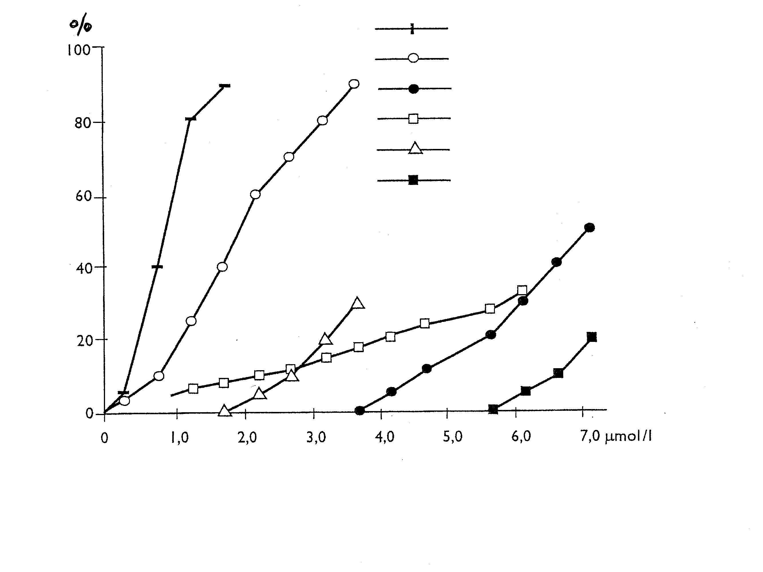
Dose-response relationship: LEAD (Pb)
decreased erythrocyte delta-ALAD
activity
increased zinc protoporphyrin
anemia
CNS effects
decreased peripheral nerve
conductivity
Nervous paralysis, lead colics
Adapted from Elinder C-G et al., Biologisk monitoring av metaller
hos människa. Arbetsmiljöfonden, Uppsala, 1991

Slide 104
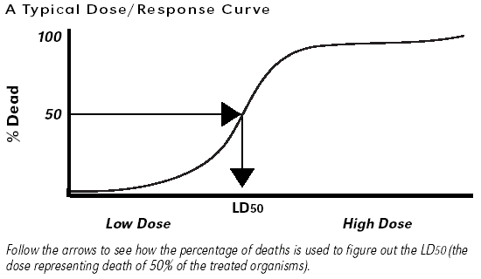

Slide 105
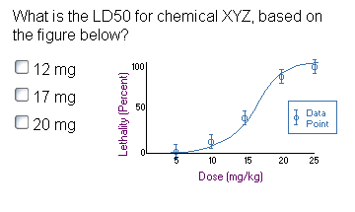

Slide 106
Kurva Dosis-Efek ( in vivo)
Slope
Maximum Effect atau Efficacy
Effect
Potency
Log Dose

Slide 107
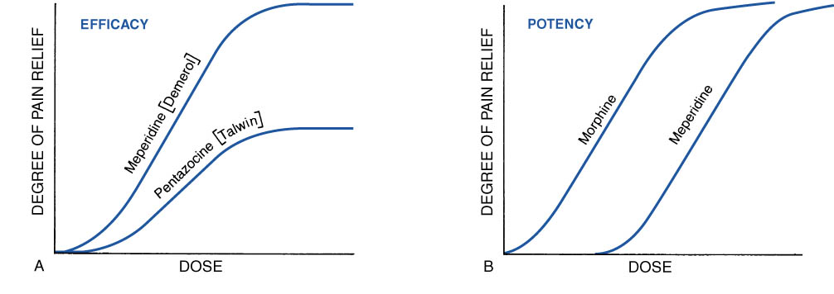
Kurva Dose - Respon in vivo
( Efficacy & Potency )
EFFICACY
POTENCY

Slide 108
Perbedaan Potensi
Dioxine
Rattle snake
100
Strychnine Sulfate
Ethyl Alcohol
% of Lethality
50
LD50
0
Dose

Slide 109
Hubungan Dosis-Efek : Phenobarbital
Therapeutic Index: LD50
ED50
Hipnotik
Mati
% Respon
ED50
LD50
Dosis Phenobarbital

Slide 110
Toxicity Studies
Acute Toxicity | LD 50,Max Tolerated Dose,2 species,2 route, single dose
Subacute Toxicity | 3 doses,2 doses, 4 weeks-3 months,
Chronic Toxicity | Rodent,non-rodent, 6 months and more
Effect on reproductive performance | Effects on animal mating behavior,reproduction,parturition,progeny,birth defects,postnatal development
Carcinogenic potential | 2 years, 2 species
Mutagenic potential | Effects on genetic stability and mutations in bacteria (Ames test) or mammalian cells in culture, dominant lethal test and clastogenicity in mice
Investigative Toxicology | Determine sequence and mechanisms of toxic action, etc

Slide 111
Qualitative Observation
CRC Handbook of Toxicology,2005
Body Weight and Food Consumption
Ophthalmology interval
Hematology parameters
Clinical Chemistry Parameters
Urinalysis Parameters
Organ Weight
Microscopic Pathology
Animal Responses
→ Clinical Signs of Toxicity
→ Autonomic Signs
Etc

Slide 112
Quantitative Observation
CRC Handbook of Toxicology,2005
Acute Toxicity
→ ED-50, LD-50, TI
Sub Chronic and Chronic Toxicity
→ ADI, NOEL, NOAEL

Slide 113
Acute Toxicity
- Acute toxicity dilakukan pertama kalinya
(biasanya oral dan IV)
- Menentuklan harga LD-50
- Binatang coba mati dlm waktu 7-14 hari period after a single dose is tabulated.
- Tanda tanda intoksikasi, lethargy, perubahan perilaku, studi biokimia harus dilakukan

Slide 114
Acute Toxicity:
(short-term exposure)
Notes:
114

Slide 115
LD₅₀
Quantal responses dihitung bila data dari populasi.
Bila mortality berupa response, maka dosis pada 50% dari populasi → LD₅₀
LD 50 paling kecil → paling toxic
Therapeutic Index (TI) is the ratio of the dose required to produce a toxic effect to that required to produce a desired therapeutic response(LD50/ED50)

Slide 116
LD₅₀ berbagai bahan kimia
Toxicant LD50 (mg/kg)
Ethyl alcohol 10,000
Salt (sodium chloride) 4,000
Iron (Ferrous sulfate) 1,500
Morphine 900
Mothballs (paradichlorobenzene) 500
Aspirin 250
DDT 250
Cyanide 10
Nicotine 1
Black Widow Spider venom 0.55
Rattle Snake venom 0.24
Tetrodotoxin (from fish) 0.01
Dioxin (TCDD) 0.001
Botulinum Toxin 0.00001

Slide 117
Subchronic toxicity tests
Uji toksisitas selama 90 hari
Dua species (rats dan dogs)
3 dosis level
Tiap dosis minimum 15 binatang (jantan/betina)
Pengamatan : Mortality, body weight, diet consumption, hematology dan clinical chemistry.
Pemeriksaan Gross dan microscopic dari tiap organs dan jaringan.

Slide 118
Long term / chronic exposure studies
Dilakukan mirip dengan pengamatan pada studi sub chronic, kecuali dengan periode lebih lama .
Mis, uji toksisitas Antimicrobial agents dan food additives.
Terutama penentuan carcinogenic potential
Dilakukan pada tikus, mice, spesies lainnya selama life spent (masa hidup) dari tiap spesies

Slide 119
Chronic Toxicity:
(repeated exposures)
Notes:
119

Slide 120
Dose levels (animal studies)
  NOEL no-observed effect level
  NOAEL no-observed-adverse effect level
  LOAEL lowest-observed-adverse effect level
  MTD maximum tolerated dose
  LD₅₀ dose which kills 50% of population
  LC₅₀ concentration which kills 50% of
  population; must include time frame
Increasing dose
120

Slide 121
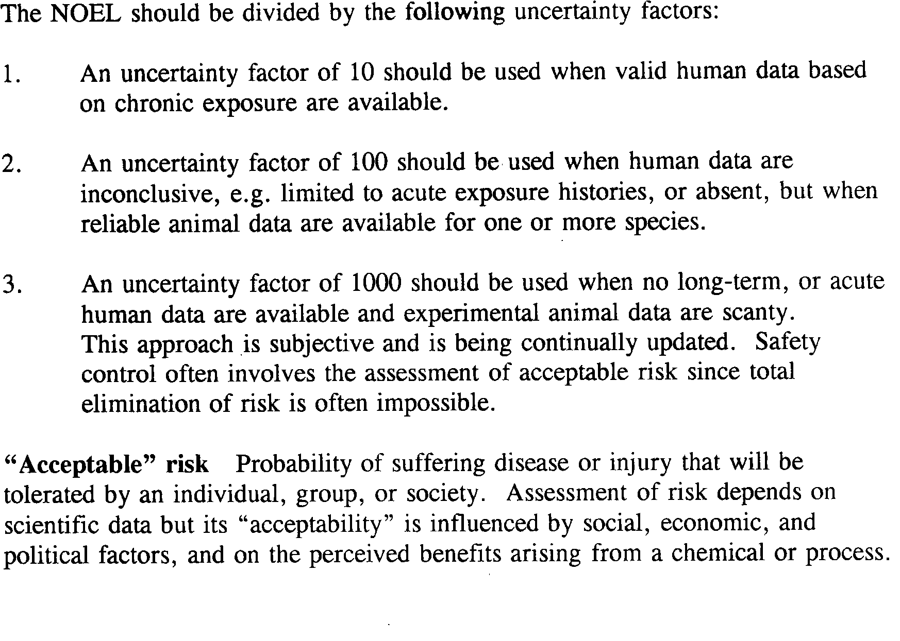

Slide 122
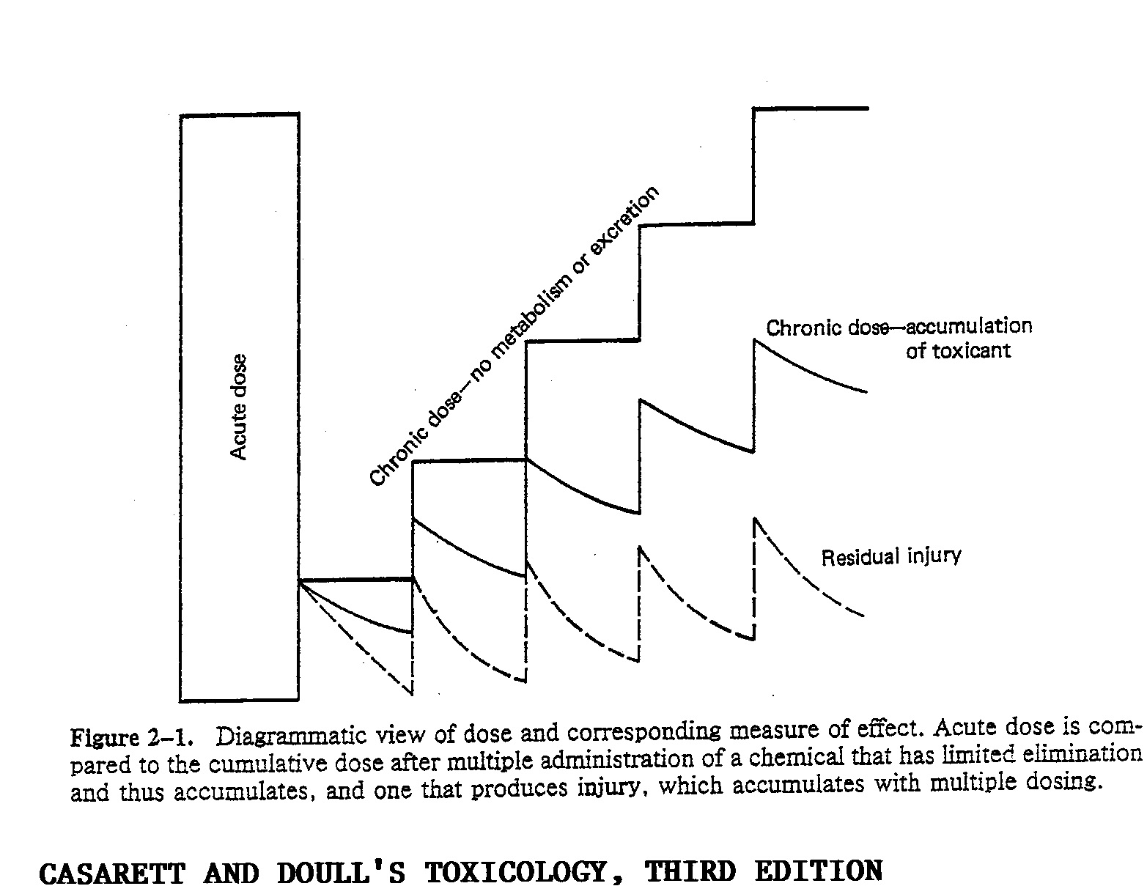

Slide 123
Toxicity Rating Chart (Casarett & Doulls)
Clasification | Probable lethal oral dose for humans
 | Dosage For average adult
Toxicity rating/ Class
Practically non toxic | > 15 g/kg | More than 1 quart
Slightly toxic | 5 – 15 g/kg | Between pint and quart
Moderately toxic | 0.5 – 5 g/kg | Between ounce and quart
Very toxic | 50 – 500 mg/kg | Between teaspoonful and ounce
Extremely toxic | 5 – 50 mg/kg | Between 7 drops and teaspoonful
Supertoxic | < 5 mg/kg | A taste (less than 7 drops)

Slide 124
Uji Dermal dan Ocular
- Uji Dermal biasanya umumnya dilakukan pada kelinci.
Chemical toxicant dikenakan pada kulit dean
dibiarkan kontak selama 4 - 24 jam.
- Iritasi kulit ditandai dengan adanya erythema
scar, pembentukan edema, sifat corrosive
- Pada Ocular test, toxicant diteteskan pada
satu mata dan lainnya sebagai kontrol pada kelinci
Perubahan pada mata diamati pada beberapa interval
ttt

Slide 126
Qualitative Observation
CRC Handbook of Toxicology,2005
Body Weight and Food Consumption
Ophthalmology interval
Hematology parameters
Clinical Chemistry Parameters
Urinalysis Parameters
Organ Weight
Microscopic Pathology
Animal Responses
→ Clinical Signs of Toxicity
→ Autonomic Signs
Etc

Slide 127
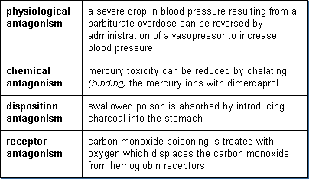

Slide 128
Toxicity rating
Toxicity rating or class
Probable lethal oral dose for human
Dosage for average adult
1. Practically nontoxic
> 15 g/kg
more than 1 quart (>0.94 L)
2. Slightly toxic
5-15 g/kg
between pint and quart (0.47-0.94L)
3. Moderately toxic
0.5-5 g/kg
between ounce and pint (28 mL-0.47L)
4. Very toxic
50-500 mg/kg
between teaspoon and ounce (5-28 mL)
5. Extremely toxic
5-50 mg/kg
between 7 drops and teaspoon
6. Supertoxic
< 5 mg/kg
a taste (less than 7 drops)
Notes:
128

